Slide 1
Business Case Study
Assessment
PROJECT SIGRID

Slide 2
context
1. introduction
2. Problem stack
3. Propose solution
4. Benefits
5. Artifacts
5.1. Gantt chart
5.2. Risk Register table
5.3. Power interest grid
5.4. Communication strategy table
5.5. Cost and resource analysis
5.6. Functional and non-functional requirements
6. KANBAN

Slide 3
1. INTRODUCTION
About
Holiday specialist
Provides
indoor and outdoor activity holidays for ALL age
accommodation for people booked for activities
accommodation for normal customers
Problems faced
Current booking system very primitive
Increase in business has caused the system to fail due to high volume of booking
Proposed change
Introduce centralised booking management system
easily accessible and manageable customer and booking details
Should facilitate pulling of necessary reports as per demand

Slide 4
2. Problem stack
Activities manager
Problems :
Information going astray DUE TO BAD PAPER WORK.
hard to tell if Course voucher IS issued or paid for.
unclear demand for Courses.
He would like to have :
A daily booking status report of each hostel.
A quarterly revenue report of all hostels.
Bookings manager
Problems :
RECORDS ARE STORED IN EXCEL SHEETS AND SEPARATE PAPER FORMS.
DELAY IN VOUCHERS REACHING THE BOOKING OFFICE
booking office unaware of the vacancies as certain bookings are made only at hostel desk
Hostel desk staff
Problems :
Staff needs to get deposit receipts from bank for all cash payments received.
different forms for each customers [course and accommodation or either of it]

Slide 5



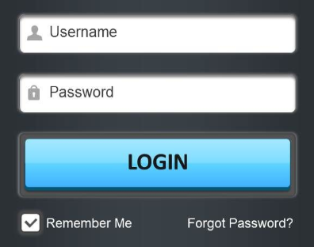








3. Proposed solution
CENTRALIZED SYSTEM
MANAGING DIRECTOR
BOOKING OFFICE STAFF
HOSTEL BOOKING STAFF
Authorisation
Authorisation
ACCOUNTS TEAM
LOGIN
ACTIVITIES MANAGER
ISSUING TEAM
Booking history
BOOKINGS MANAGER
Booking form
Availability
Reports
USERS
PAYMENT
Updating payment and availability
DATABASE

Slide 6
4. BENEFITS
Ease of access for everyone and can get updates regarding bookings and accounts Realtime.
The reports introduced will give an overview of the bookings and revenue
A digital payment only system will help keeping track of the paid and unpaid vouchers.
The chance of missing customer/booking details will be eliminated.

Slide 7
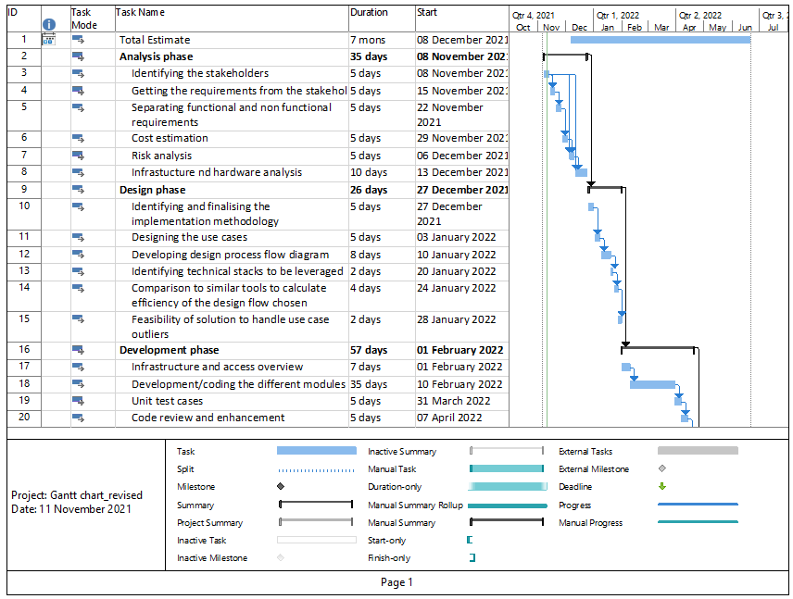
5. ARTIFACTS
5.1. Gantt chart

Slide 8
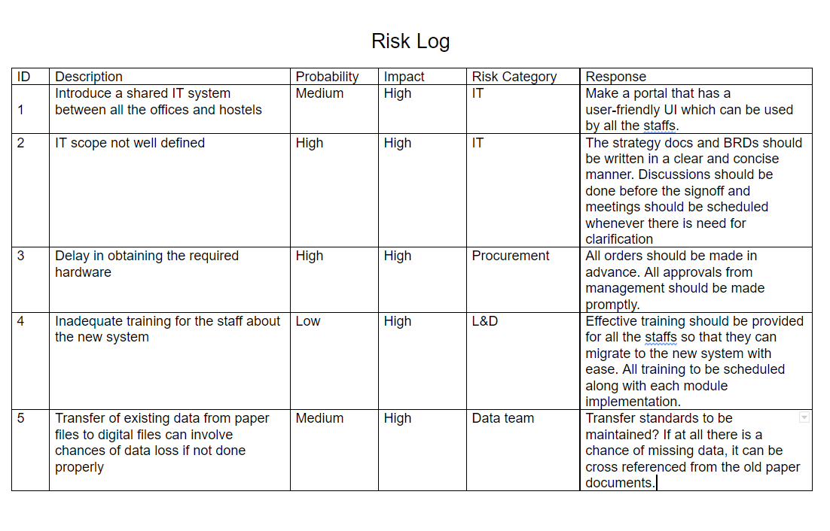
5.2. Risk Register table

Slide 9
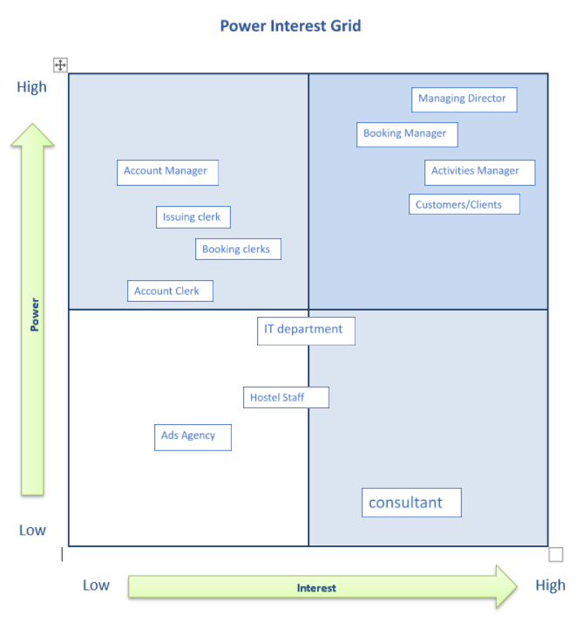
5.3. Power interest grid

Slide 10
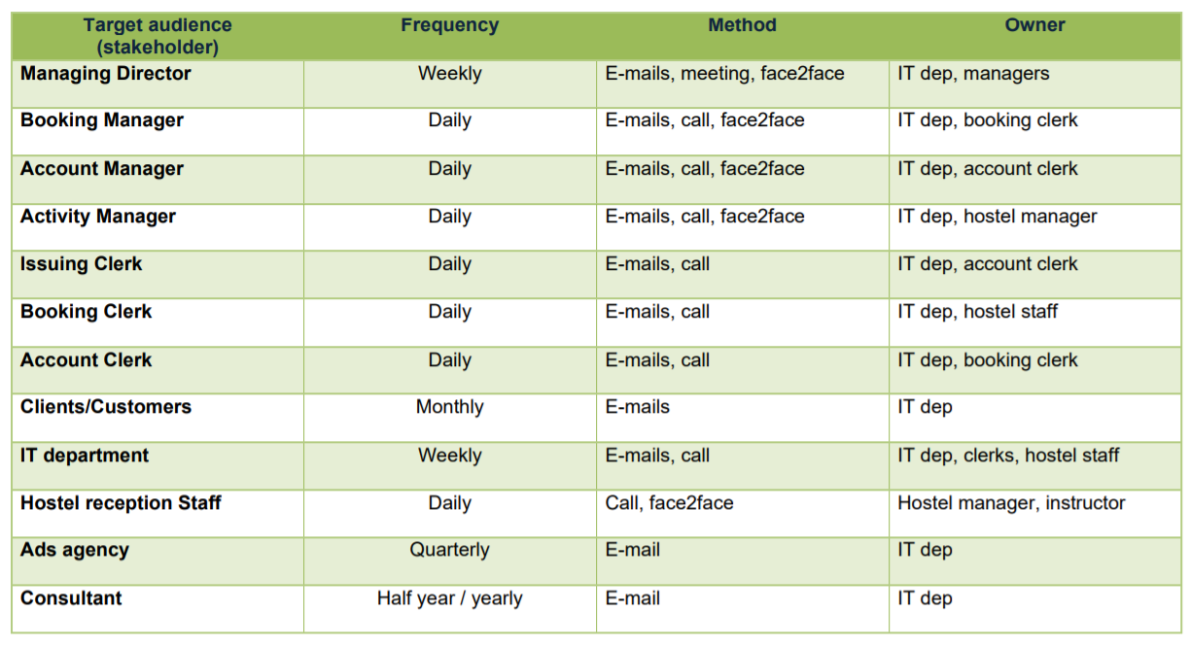
5.4. Communication strategy table

Slide 11
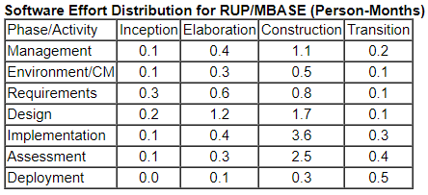
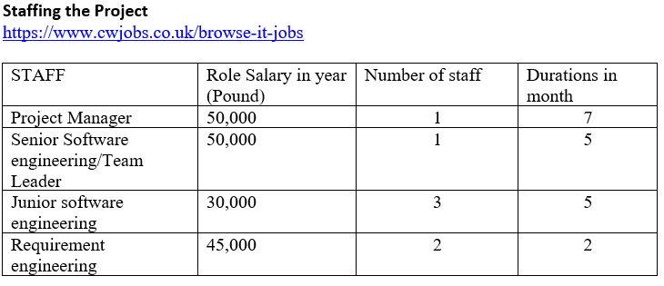

5.5. Cost and resource analysis

Slide 12
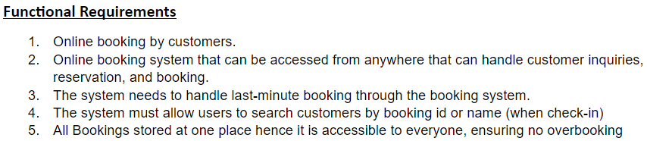
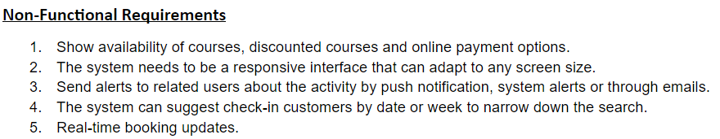
5.6. Functional and non-functional requirements

Slide 13
6. KANBAN
the proposing system will be a small-scale booking management system with a reporting section. As the client is looking for a fast solution to handle their business, it is important to adopt a flexible methodology to deliver the project.
The proposed system solution will be an in-house system meaning continuous updates and changes won’t be an option.
prevents overproduction, lowers costs, and makes operations more reflective of the demands of the market.
producing the exact quantity of products that are required.
achieve a steady flow of work, all units within the Kanban system should only produce the number of tasks based on the capacity.
Fine-tune the Development / Process Optimization.
Stabilize and Rationalize the Process.

Slide 14
THANK YOU VERY MUCH!!

